Slide 1
Political Relational Influencers: The Mobilization of Influencers in the Political Arena
11.16.2023
Samuel Woolley, PhD
Program Director, CME Propaganda Research Lab
Assistant Professor, School of Journalism & Media
Fellow, R.P. Doherty, Sr. Professorship in Communication
mediaengagement.org | @engagingnews

Slide 2
Outline for this talk
The Propaganda Research Lab @ UT Center for Media Engagement
The evolution of computational propaganda
Political relational influencers
Paths for future work

Slide 3
01
The Propaganda Research Lab
The Center for Media Engagement
Moody College of Communication
UT at Austin

Slide 4
The Propaganda Research Lab
Team: faculty, graduate, undergraduate, professional, and affiliate researchers
Mixed methodology: Ethnography meets computational social science
Comparative and international perspective
Focus on information manipulation campaigns using emerging technology
We are focused on how emergent technologies are used for the purposes of persuasion in global communication. Our work on computational propaganda has revealed the ways in which a wide variety of political groups worldwide have leveraged tech such as bots and trending algorithms and tactics of disinformation and trolling in efforts to control information flows online.

Slide 5
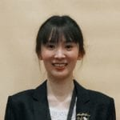
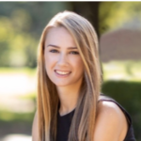
The Team

Slide 6
02
The Evolution of Computational Propaganda
Bots, Influencers, AI

Slide 7
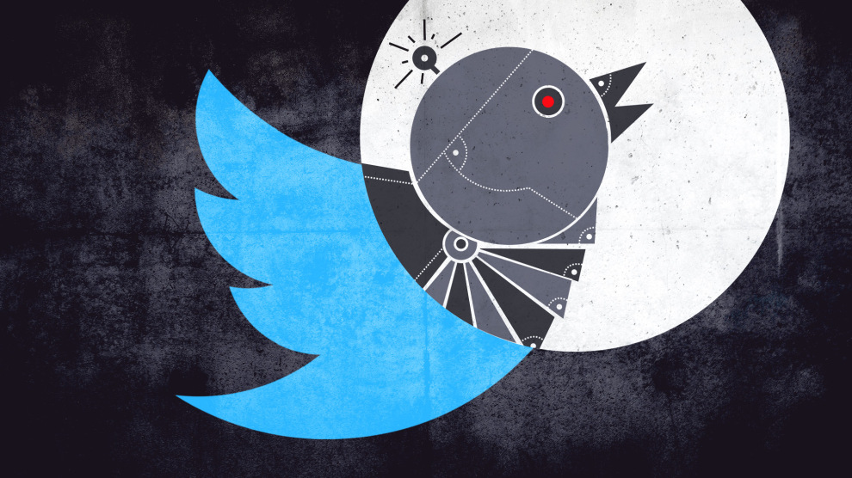
Computational propaganda: 2016 to Today
In 2016, concerns about computational propaganda came to a head with Russian manipulation during the U.S. Presidential election that year. But similar occurrences were happening globally prior to this.
Today, campaigns have shifted from the use of clunky, impersonal, bots and towards more “relational” efforts leveraging influencers and more sophisticated AI bots. They are also take place across a wider range of platforms.

Slide 8
03
Political Relational Influencers: The Mobilization of Influencers in the Political Arena
Goodwin, Joseff, Riedl, Lukito, & Woolley (2023).
International Journal of Communication, Vol. 17.

Slide 9
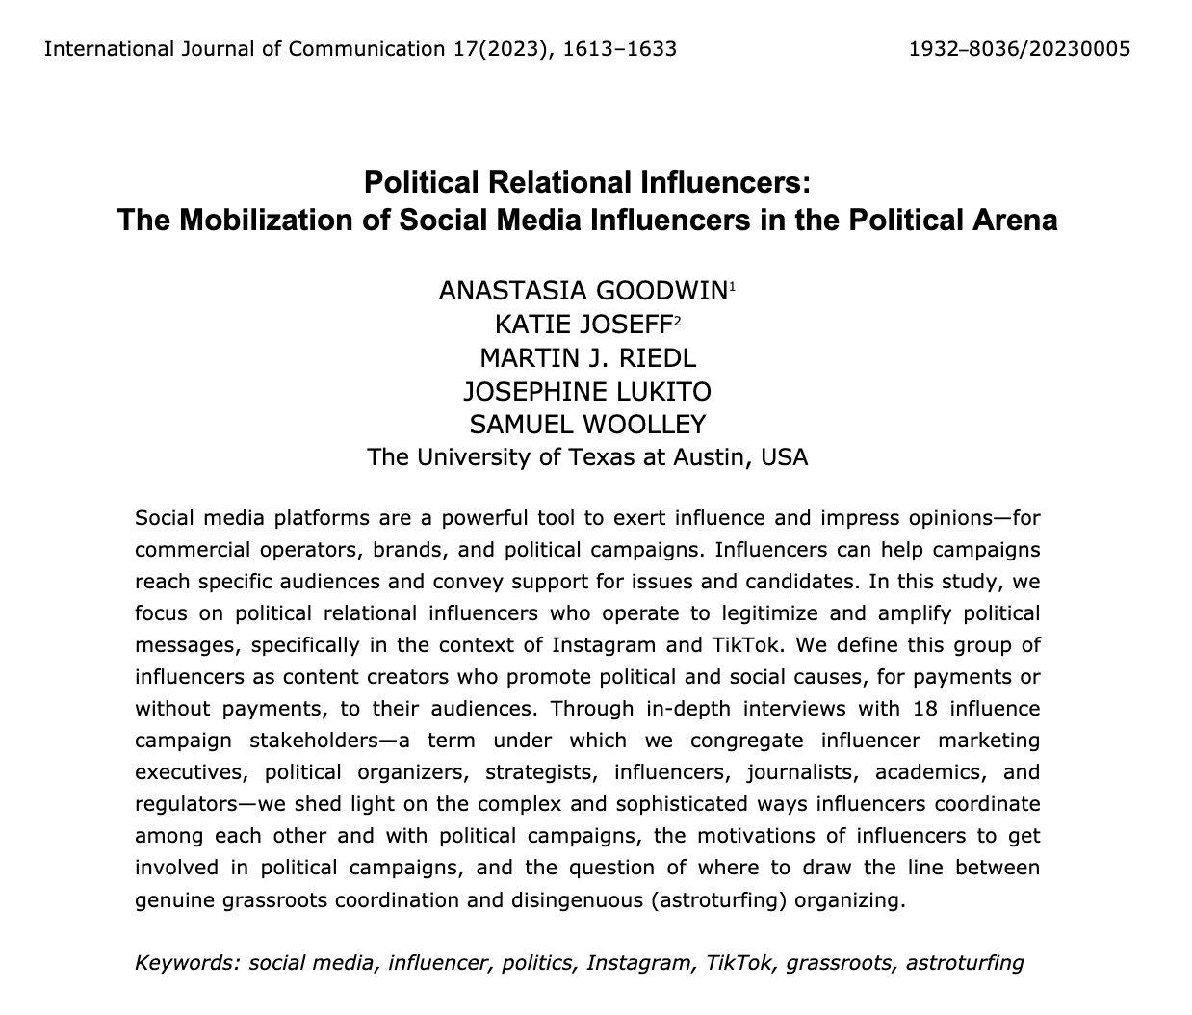
Background

Slide 10
Defining “Political Relational Influencers”:
“Content creators who promote political and social causes toward their audiences by expressing support for them and endorsing them implicitly or explicitly. They are different from influencers in other topical domains in their willingness to associate their online influence with political and social causes”

Slide 11
Methods
18 semi-structured, in-depth, interviews w/ influence campaign stakeholders
Interviewees selected via non-probability purposive/snowball sampling
Two interviewers for each interview
Average of 45 minutes long, recorded, conducted via zoom
Anonymity granted to interviewees
Focus on TikTok and Instagram
Thematic memos created after each interview
UT Austin IRB on 10.31.2019

Slide 12
Research Questions
RQ1: Why are influencers motivated to engage with political issues?
RQ2: How does coordination happen among political organizers and influencers?
RQ3: Where do influence campaign stakeholders map political relational influencing on a spectrum between genuine (grassroots) coordination and disingenuous (astroturfing) organizing?

Slide 13
Core Findings
For political and electoral campaigns, engaging with relational influencers as a campaign tool is only getting more important.
A greater level of coordination between political organizers and relational influencers—and among the influencers themselves—than may have been expected.
Relationship between campaigns and the relational influencers they are working with must be mutually beneficial.
Notes:
1) As intermediary companies connect political campaigns with ever-more influencers, and as influencer management tools (Bishop, 2021) become more
readily available, the relationships between political campaigns and influencers are likely to become more professionalized, sophisticated, and structured (Stoldt et al., 2019).
2) In addition to the explicitly political collectives of influencers (e.g., Conservative Hype House, TikTok Leftists), our interviews highlight the variety of ways in which political campaigns strategize and incorporate relational
influencers into their broader advertising campaigns. While political campaigns at times might think hierarchically about influencers as one element in top-down communication structures, influencer firms and
marketing executives are cognizant that communicating with influencers requires political campaigns leveling with influencers. For example, Biden’s campaign reported low rates of returns from influencers wanting to post on behalf of campaigns. While it is beyond the scope of this article to assess the quality of this specific campaign, it highlights the difficulty in engaging in this hybrid coordination of political messaging
(Chadwick, 2017).
3) In this dynamic, political campaigns hold power to some extent (they are, after all, the ones with the pocketbook). However, influencers carry a lot of communicative power: They may be able to engage and mobilize voters that campaigns cannot reach. Furthermore, for either performative or personal reasons, influencers are very selective about the issues they promote—there are few ways to get an influencer to promote a political position they do not personally believe in. As a result, influencers may have substantial bargaining power when coordinating with political campaigns.

Slide 14
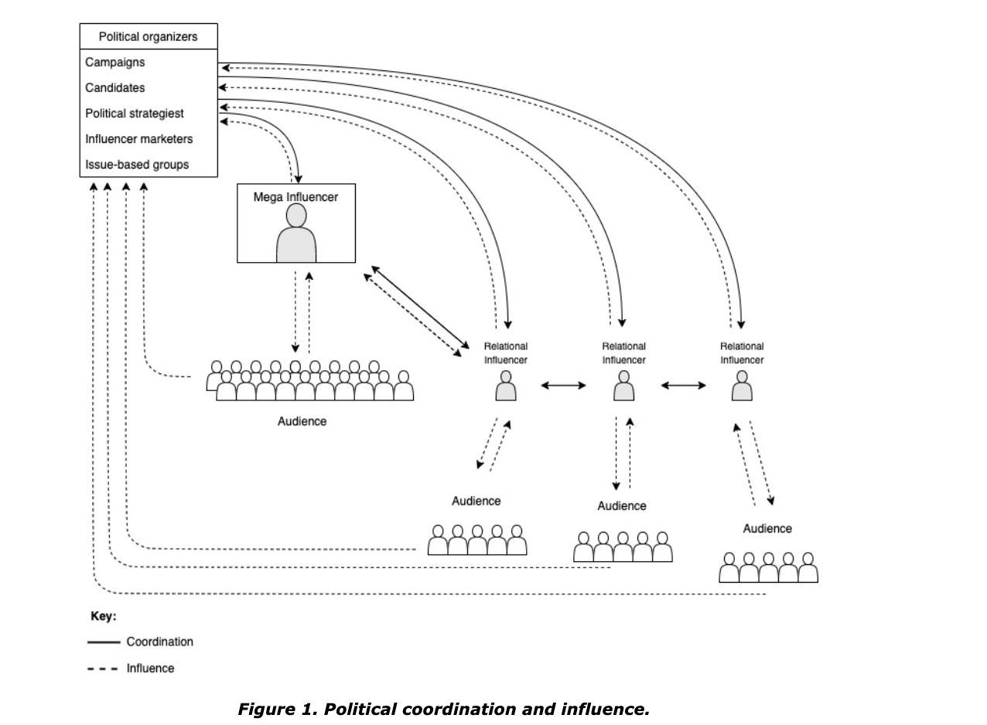
Coordination and Mechanics of Influence
Notes:
This figure highlights two dynamics across three sets of actors. The first dynamic is coordination,
which occurs between political organizers and political relational influencers and among influencer
communities, sometimes by posting around the same time or strategically promoting one another’s content.
Owing to the elevated status of political speech compared to other forms of speech in the United States, the
ability of influencers to monetize their social media activities by engaging in political speech has raised
thorny legal and ethical questions (De Gregorio & Goanta, 2022).

Slide 15
04
Concluding Thoughts
Regulation, motivations, future work

Slide 16
Final Thoughts
Our results underscore the gray area in which political influencers operate. Given the absence of strict regulatory requirements from the FEC regarding disclosure (Naylor, 2020; Notopoulos, 2020), U.S. influencers can work with political campaigns relatively unencumbered and without disclosure, regardless of whether their work is remunerated or not.
Additionally, there is a greater question of whether influencers are genuinely motivated to post about politics or whether they are pressured into it—be that directly via campaigns or through influencer marketing firms that operate as intermediaries between campaigns and influencers.
Notes:
1) However, the levels of sophistication and coordination among campaigns and influencers raise questions about when this activity can be seen as grassroots organizing
(Ryan, 1991), and when it dips into astroturfing (McNutt & Boland, 2007). The critical distinction between influencer work that qualifies as grassroots organizing versus astroturfing lies in the question of motivation,
intent, and disclosure.
2) While political campaigns may not be able to put pressure on influencers, the audiences of these influencers may become
increasingly vocal if an influencer does or does not engage in a social issue. As political relational influencing becomes more popular, we expect to see a greater level of organization. Already, researchers have found that as the industry matures, influencer management tools and third-party agents managing influencers reify inequalities and hierarchies (Bishop, 2021).

Slide 17
Related Reading
Social Media + Society (2023), special issue on Political Influencers. Riedl, Lukito, and Woolley.
Journal of Democracy (2023), Digital Propaganda: The Power of Influencers. Woolley.
Notes:
1) However, the levels of sophistication and coordination among campaigns and influencers raise questions about when this activity can be seen as grassroots organizing
(Ryan, 1991), and when it dips into astroturfing (McNutt & Boland, 2007). The critical distinction between influencer work that qualifies as grassroots organizing versus astroturfing lies in the question of motivation,
intent, and disclosure.
2) While political campaigns may not be able to put pressure on influencers, the audiences of these influencers may become
increasingly vocal if an influencer does or does not engage in a social issue. As political relational influencing becomes more popular, we expect to see a greater level of organization. Already, researchers have found that as the industry matures, influencer management tools and third-party agents managing influencers reify inequalities and hierarchies (Bishop, 2021).

Slide 18
THANK YOU
Samuel C Woolley, PhD
swoolley@utexas.edu

