Slide 1
Implications of the Reformed EU-ETS for Rapid Decarbonization
Michael Pahle
Workshop „Carbon Emission Pledges and Corporate Decarbonization Initiatives “
27 Sep 2023

Slide 2
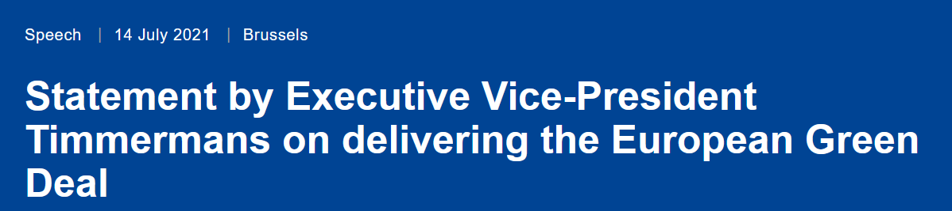
Role of emission trading for EU climate reform
In many ways, the ETS is front and center to all our efforts.
With its cap on emissions, it is a proven and effective tool to bring down emissions.
It gives a price signal to industry to switch to cleaner production, it drives innovation
It generates revenues for redistribution and reinvestment.

Slide 3

EU ETS reform: The „biggest climate law ever“

Slide 4
Essence of the reform: tighter cap(s)
2039
(reform)
2057
(pre-reform)

Slide 5
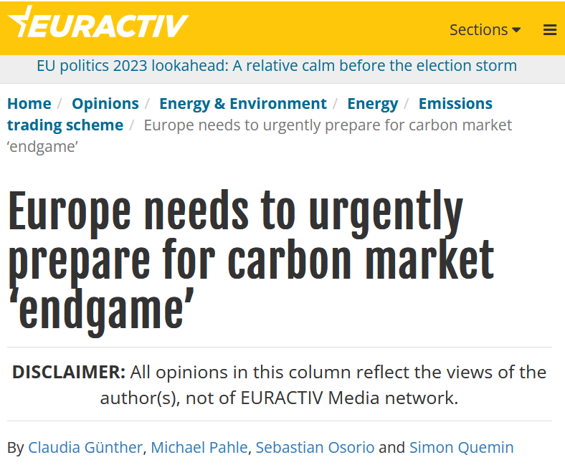
End of supply around the corner, emerging “endgame”

Slide 6
Reform begs important questions
ETS “endgame” in the next decade, overlaps with current investment horizons
1. How will the market(s) react to the reform?
2. Necessary future adjustments of market in light of that?
Source: Quemin & Pahle (2022)

Slide 7
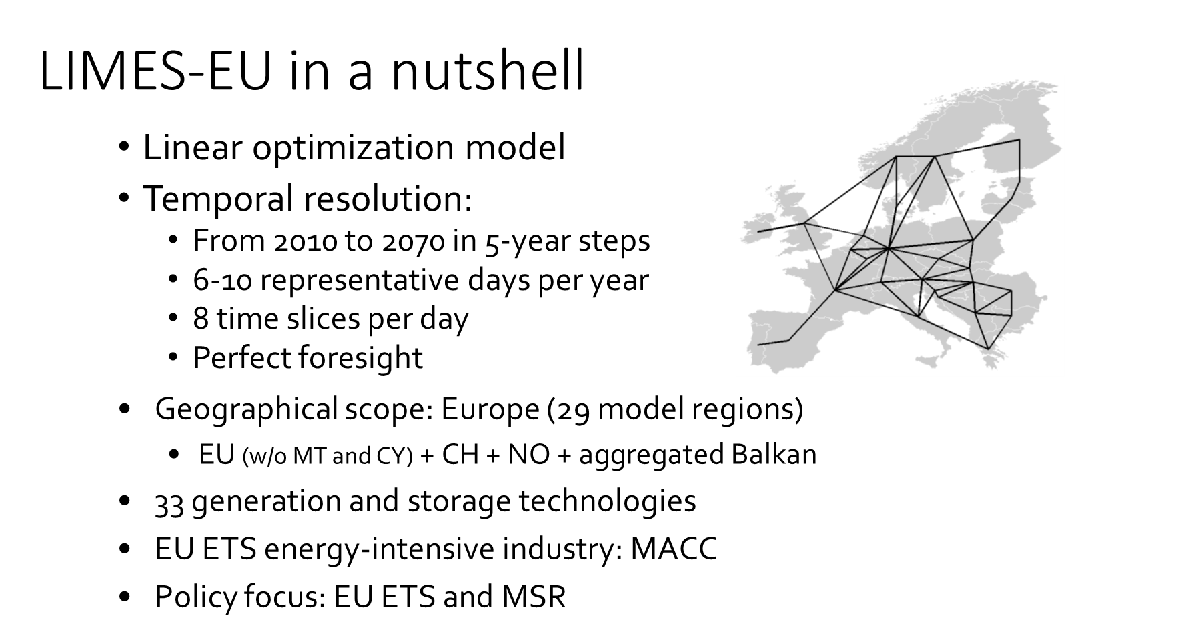
Methods
Part I: Ceteris paribus analysis using the LIMES-EU model
Part II: Qualitative deep dive with a focus on industry

Slide 8
PART I: Model-based analysis of market dynamics

Slide 9
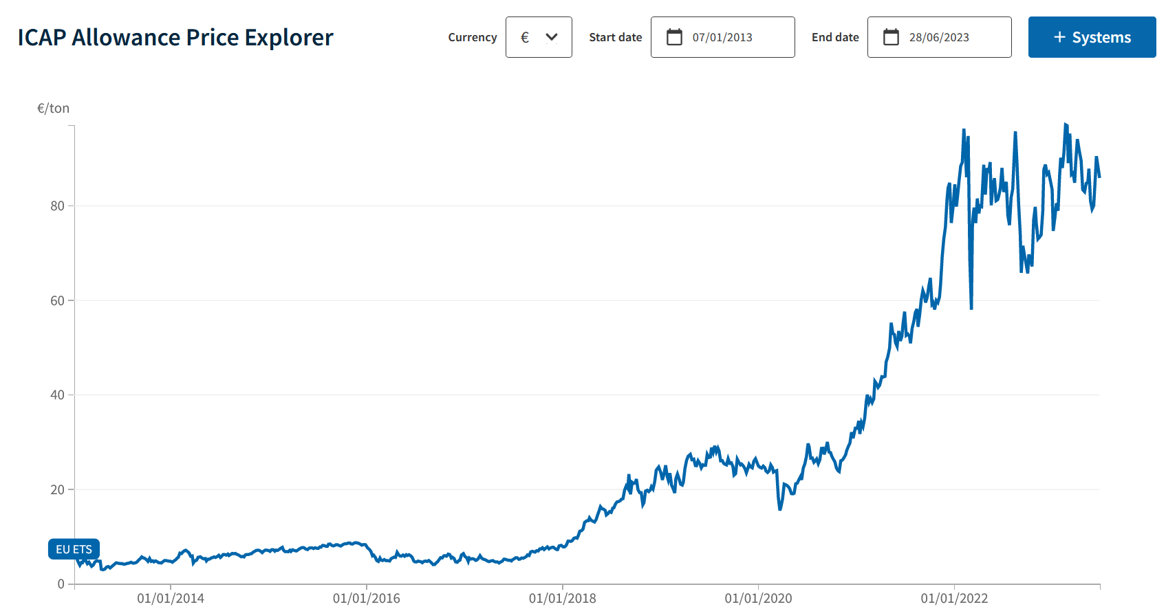
Historical EU ETS allowance prices
80 €/t
60 €/t
40 €/t
20 €/t
Jan 2016
Jan 2018
Jan 2020
Jan 2022

Slide 10
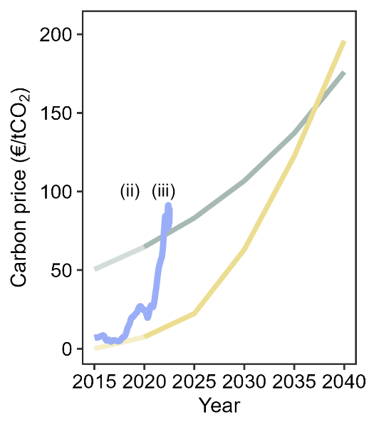
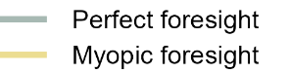
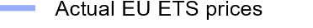
Is a perfect foresight model actually suited?
Myopic version of LIMES (10y horizon) captures actual prices before 2018 quite well
Perfect foresight version performs better from 2022 onwards
Consistent with reforms having made market (much?) more forward looking
Source: Sitarz et al.
(R&R Nature Energy)

Slide 11
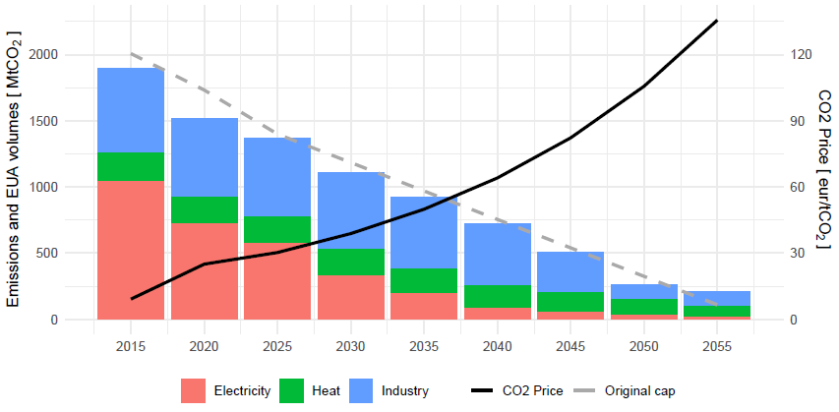
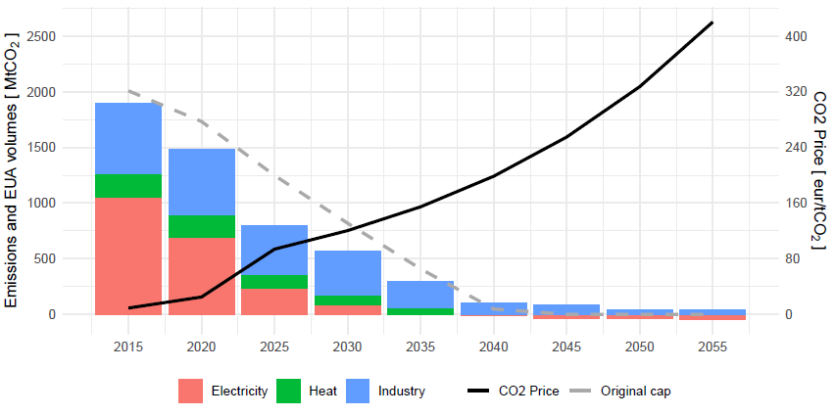
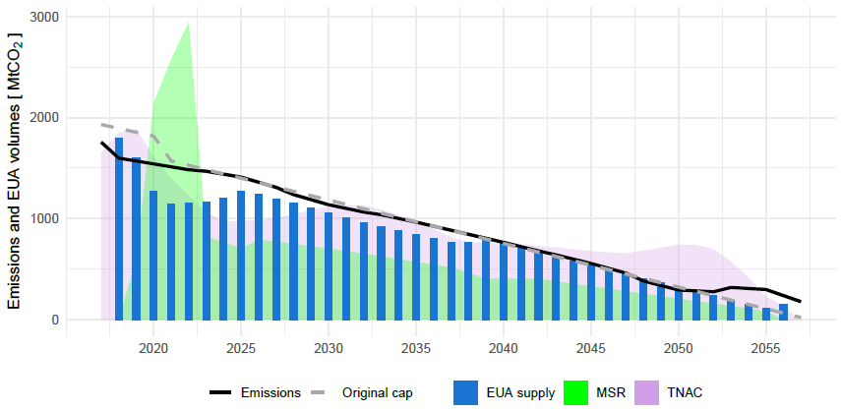
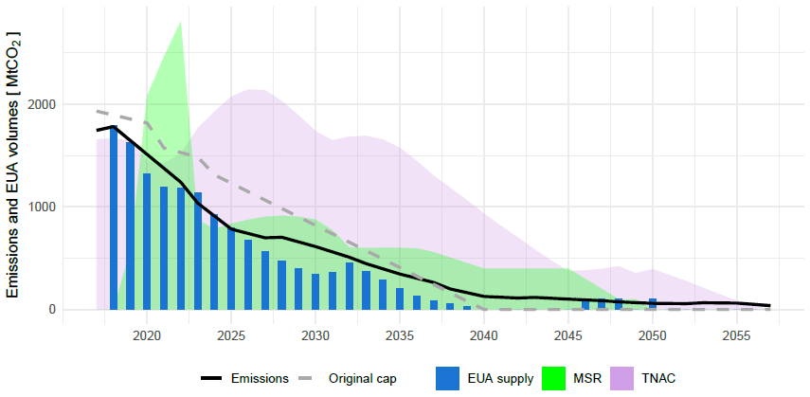
Market dynamics pre/post Fit-for-55 reform
Pre reform (LRF=2.2%)
Post reform
(LRF=4.2%)
Emissions / EUA vol. [Mt]
Emissions / EUA vol. [Mt]
EUA price [EUR/t]
EUA price [EUR/t]
Emissions / EUA vol. [Mt]
Emissions / EUA vol. [Mt]

Slide 12
Endgame may start around 2030 already...
Post reform
ETS increasingly price set by “residual” emissions: industry MAC and electricity CCS
TNAC (bank) to rise again, peaking ~2025
  Anticipation of much costlier abatement in later decades
  Can be interpreted as “hedging”
High MSR intake, supply as small as 500 Mt by 2030 already

Slide 13
Industry MACC in the LIMES model
Marginal abatement costs based on BDI „Klimaschutzpfade“ study (2018)
Mostly energy efficiency measures and CCS
CCS availability (infrastructure, national legislation) and costs still very much an open issue…

Slide 14
PART II: Deep Dive on Industry

Slide 15
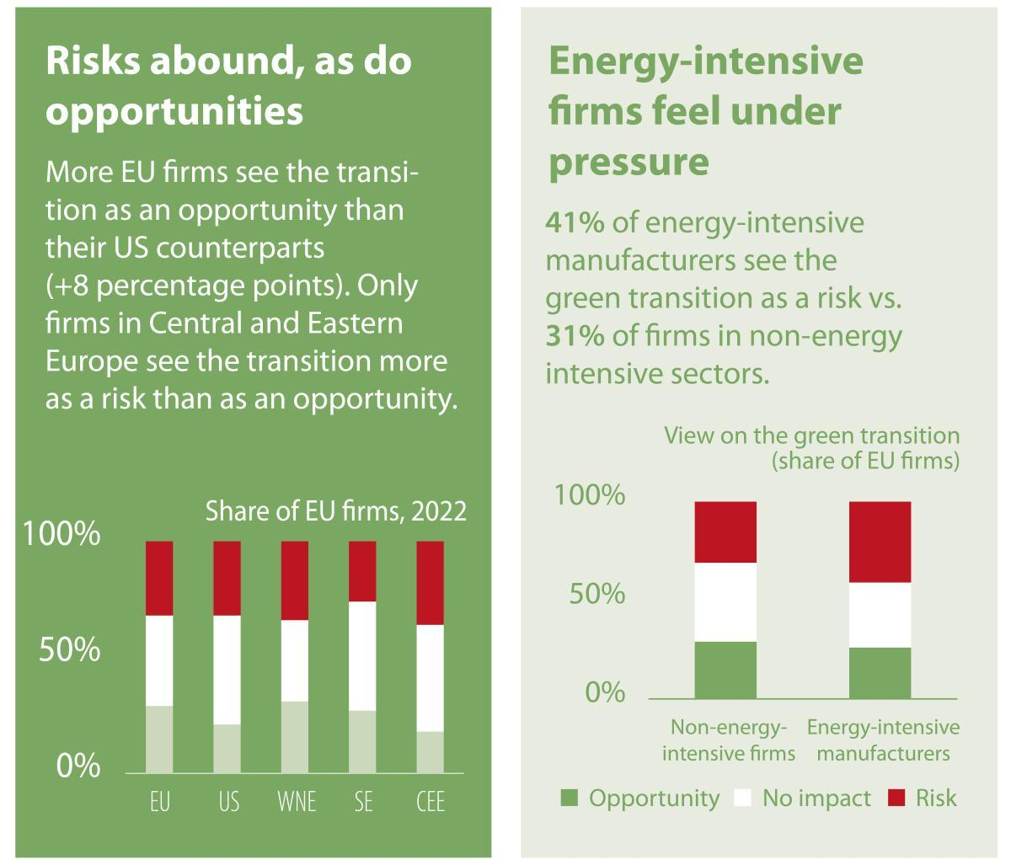
Firms’ expectation crucial for post-2030 “endgame”
When firms see ETS/transition largely as an opportunity ⇔ price stability (as in the model)
  The more investments are postponed, the stronger the price will rise*
Likely post-2030 pressure (relieve) points:
  Banking and investment
  Additional carrots and sticks from ETS revenues and member states
  Carbon removals (CR) and CCS
Source: EIB Investment Survey 2022-2023
* Pahle et al. (2023): Safeguarding the energy transition against political backlash to carbon markets.

Slide 16
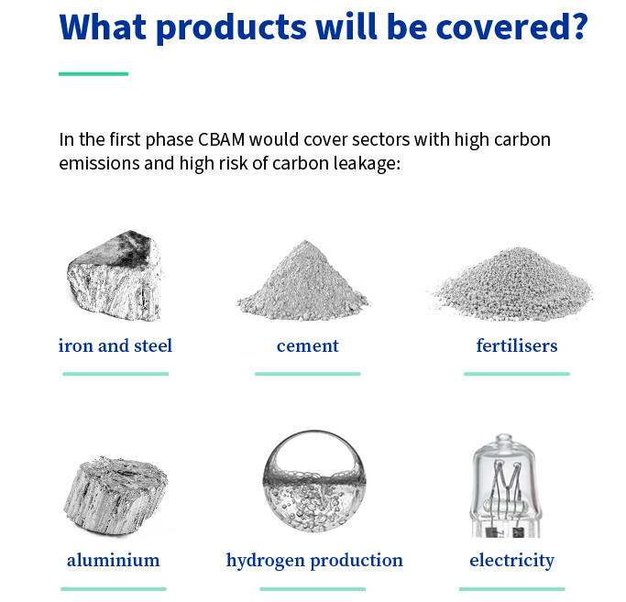
Banking and investments: financing needs
Free allocations of allowances to be phased out until 2034 for key sectors (-> CBAM)
Likely that free allowances generated (some) windfall profits in the past
  some allowances still “hoarded” (Quemin & Pahle 2022)
Current situation: no more windfalls, industry under pressure (demand slump)
Sufficient finance (access) to bank allowances and invest?
Source: European Council

Slide 17
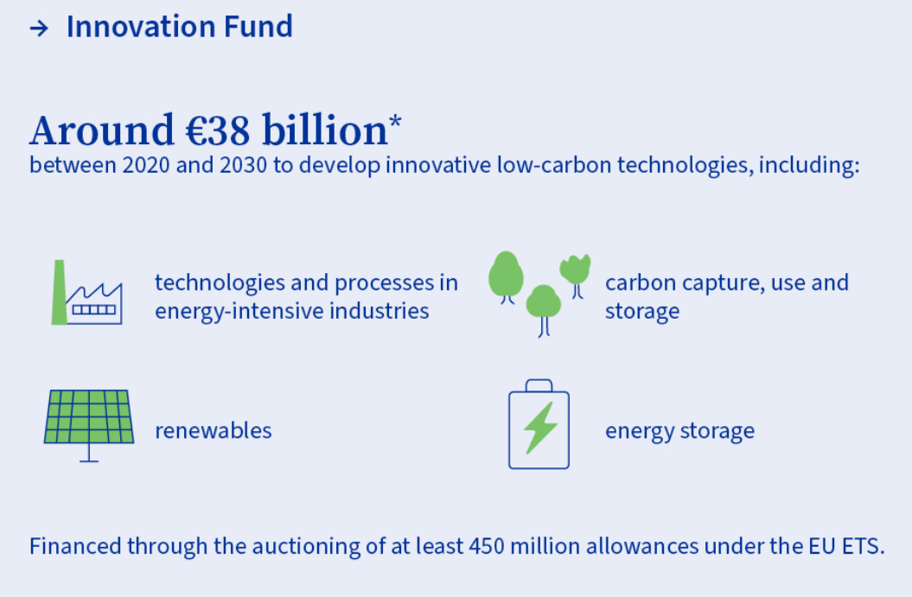
Substantial additional carrots…
EU Innovation Fund strengthened in reform
In some countries substantial additional support, e.g. DE:
  CAPEX subsidies (federal and state level)
  CCfDs (Klimaschutzverträge)
  Temporary fixed electricity rate? (Brückenstrompreis)
Source: European Council

Slide 18
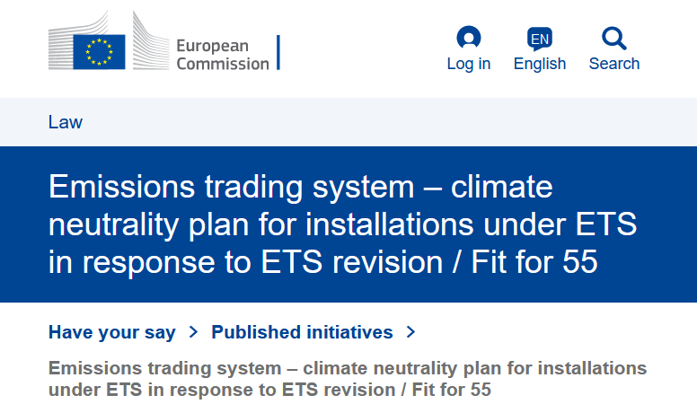
…and a little stick for laggards
[F]rom 2026 onwards, the free allocation of emission allowances to the 20 % stationary installations with the highest emission intensities under a given product benchmark should also be conditional on the setting-up and implementation of climate-neutrality plans.

Slide 19
Carbon removals
Carbon removals (CR) required to compensate residual emissions
Challenges:
  Potential and costs uncertain, also hinges on policy pathway
  Non-permanent CRs could be “gap filler”, but integrity risk
Integration into ETS not at matter of if, but when an how
  Liability risk for non-permanent CRs => Carbon Central Bank?*
  Policy proposal already on the table in California
Source: EU Scientific Advisory Board on CC (2023)
*Edenhofer, Franks, Kalkuhl, Runge-Metzger (2023): On the Governance of Carbon Dioxide Removal – A Public Economics Perspective

Slide 20
Current state of CDR
New legislation on certification in the making, date of adoption unclear
Main controversies
  Include nature-based CDR or not?
  Specify later use (integration in the ETS) or not?
Timeline:
  Ideally proposal for integration in early 2025
  “Backstop” clause: EC to carry out an impact assessment by 2026
In parallel, policy debates and action on national level...

Slide 22
Summary
Pending ETS reform will substantially tighten supply by around 2030 already  ETS approaching “endgame”
ETS the main stick for driving (and accelerating) industry decarbonization, so far quite effective in shaping expectations
However, a lot of enabling conditions (carrots, infrastructure) required: policy in the making, but outcome still unclear
  Very important: negotiating this policy a strategic game
Years up to 2026 will be decisive for clarity about long term ETS framework, in the meantime EU member states policy driving force

