Slide 1
Phase-out policies
Estelle Cantillon
Université Libre de Bruxelles, TSE and CEPR

Slide 2
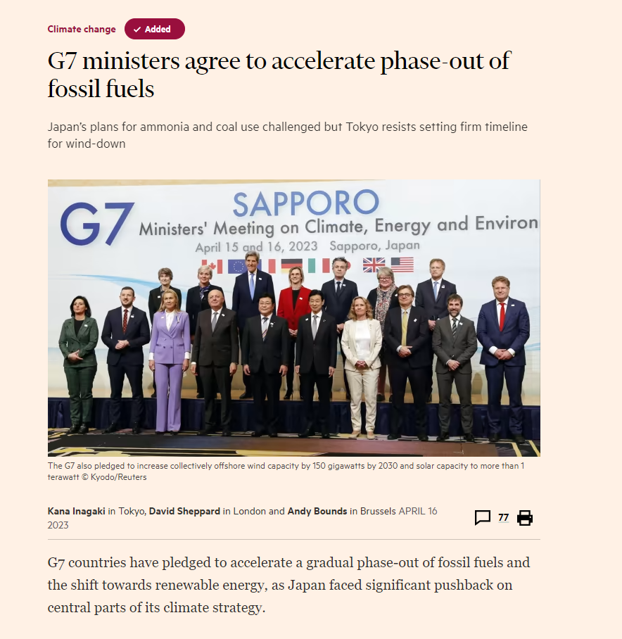
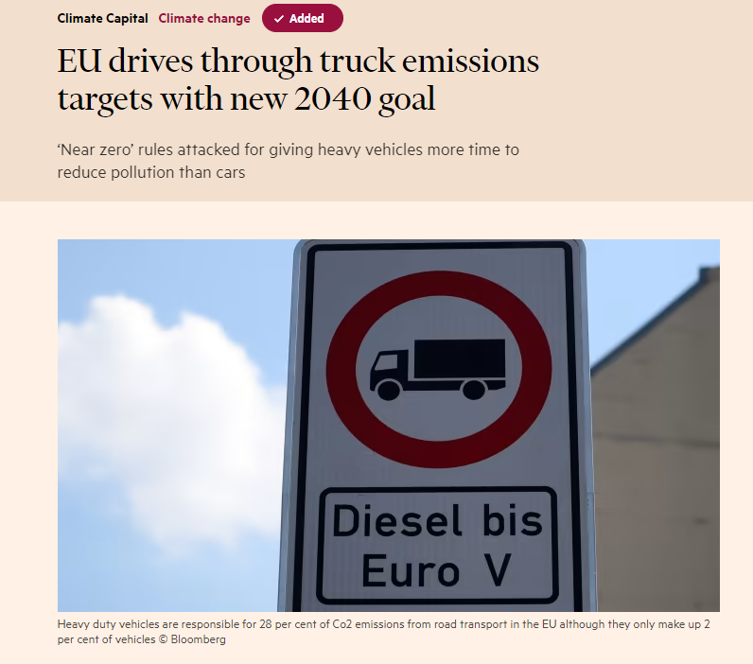
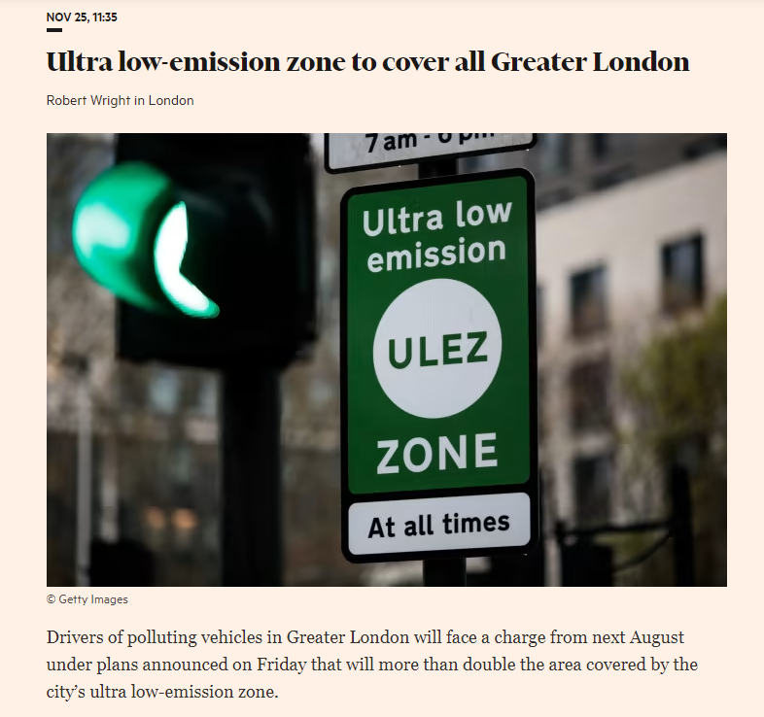
Phase-outs are popular
Notes:
Phase-out policies are policies that rule out the use or sale of specific technologies or products by a certain date

Slide 3
Why phase-outs for decarboniSation?
Fossil-based emissions largely driven by long-lived equipment
(electricity production, transport, heating)
Phase-out policies account explicitly for the time dimension of the problem at hand

Slide 4
A first look at the economics of phase-outs
Two technologies (brown and green) characterized by their investment cost and carbon-intensity of use
Green technology more expensive to buy, cheaper to operate
Use is price inelastic
Suppose the total cost of ownership for the brown technology is lower
How to decarbonize ?
Option 1: Ban new sales of brown technology (phase-out)
Option 2: Price carbon until cost of ownership of green technology lower
Same outcome (all new sales are green) but different financial impact on consumers and public finances
Under a carbon price, locked-in consumers negatively impacted with no alternative

Slide 5
Additional considerations
Uncertainty about costs and consumer behavior
Consumer behavior: agency over intensity of use, short-sightedness, split-incentives problem
Social acceptability (“you cannot pay your way out”)
Industrial policy and supply chain coordination

Slide 6
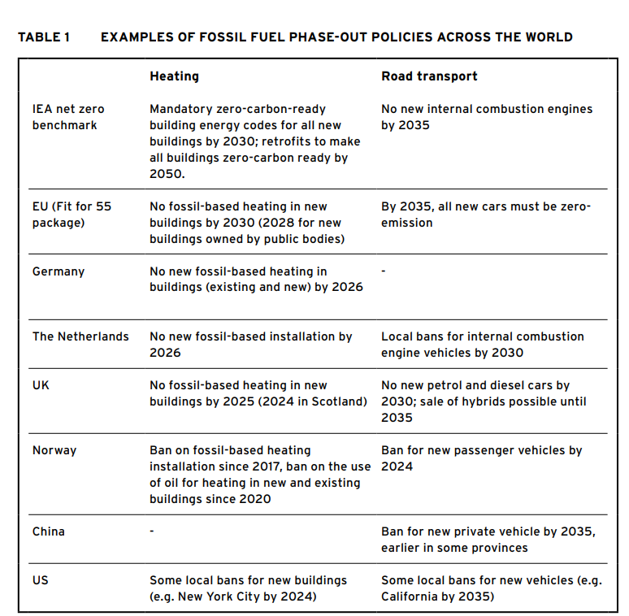
Take-aways – when to consider phase-outs ?
Long-lived assets
Equity concerns are salient
Use is inelastic (captive consumers)
Short-sighted consumers or split-incentives
Infant alternative technology likely to benefit from market push
Lots of arbitrage, need for additional research to quantify them.

